Slide 1


Bird Species Classification Using Deep Learning
Institute of Advanced Computing and Software Development, Pune
e-DBDA MAY-2021
Project Guide-
Akshay Tilekar
BY:
Ankit S. gawande- 1306
Rutuja D. Kardile- 1322

Slide 2
CONTENTS:-
Aim and Objectives
Dataset
Convolution Neural Network
Transfer Learning
Model building
Accuracy
Testing
Conclusion

Slide 3
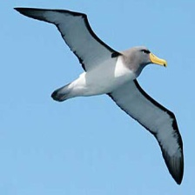
AIM:
Build a model using deep learning algorithms and image processing to predict the species of birds by taking their image as input.
OBJECTIVES:
To use deep learning algorithms and predict the bird species.
To get best testing data accuracy.
Train the model on 275 types of birds on over 40k+ images.
Use CNN to build model
Used Pretrained model Transfer Learning Techniques.

Slide 4
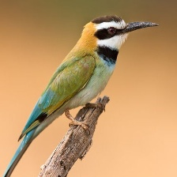
DATASET:-
There are training, testing and validation set of images of birds. The dataset comprises 275 types of species.
Train Dataset- The training dataset are provided different types of bird images. There are about 39000+ images in the training data.
Validation Dataset- The validation dataset contain 5 images of each class.
Test Dataset- The test dataset contain 5 images of each class.

Slide 5
CONVOLUTION NEURAL NETWROK:-
A convolutional neural network (CNN) is a type of artificial neural network used in image recognition and processing that is specifically designed to process pixel data.
It consists of three layers-
Input Layer
Hidden Layer
Output Layer

Slide 6
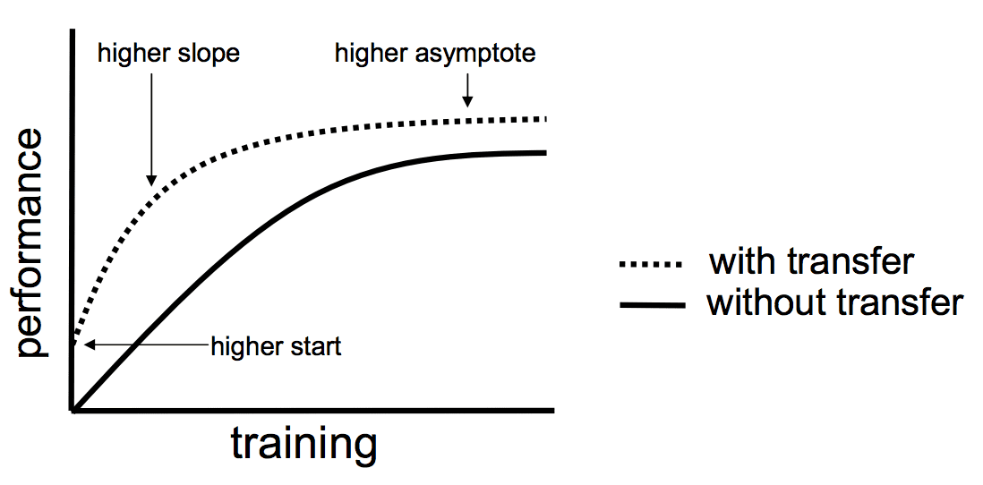
TRANSFER LEARNING:-
Transfer learning is the improvement of learning in a new task through the transfer of knowledge from a related task that has already been learned.
Why Transfer Learning –
To use Pretrained model
Better Accuracy

Slide 7
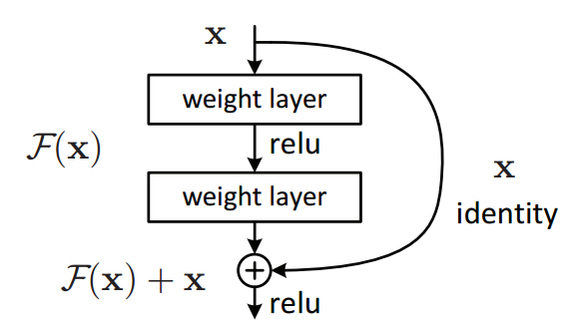
ResNet101V2:-
Import ResNet101V2 from keras.
Residual Neural Network.
Functional Model
Skip connections

Slide 8
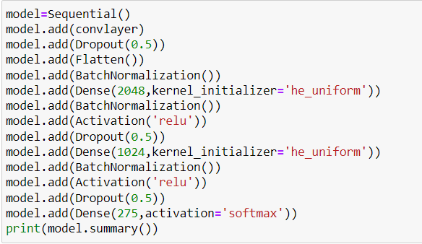
MODEL BUILDING:-
Model consists of different layers:-
Convolution Layer
Pooling Layer
Dropout
Flatten
BatchNormalization
Dense
Activation

Slide 9
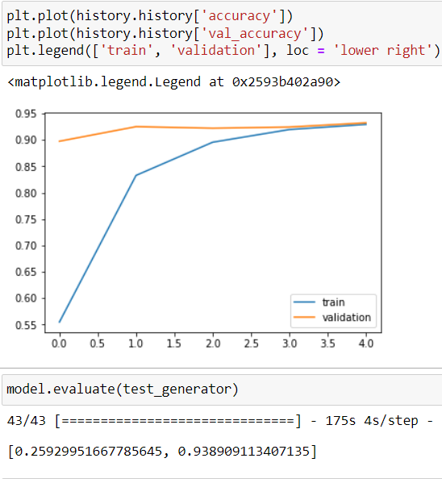
ACCURACY:-
Accuracy Plot
Model Accuracy- 93.89%

Slide 10
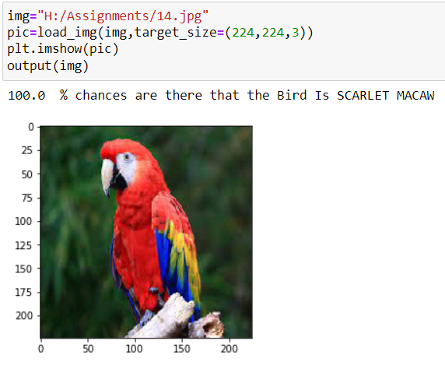
TESTING:-
Successfully predict the type of bird.
Model gives very accurate result of identifying bird’s species.

Slide 11
FUTURE SCOPE:-
In industry and even academia, developing a CNN is challenging because there is very little established methodology on determining the architecture, and conventional hyper-parameters but again not particularly well understood mechanisms for selecting them. System can be implemented using cloud which can store large amount of data for comparison and provide high computing power for processing (in case of Neural Networks).

Slide 12
CONCLUSION:-
Deep learning models have a very great capability to surpass the human potential if the data provided is sufficient.
we give input bird image to generated system it gives desired output.
The system has provided the 93.89% accuracy in prediction of finding bird species.

Slide 13
THANK YOU

